Slide 1
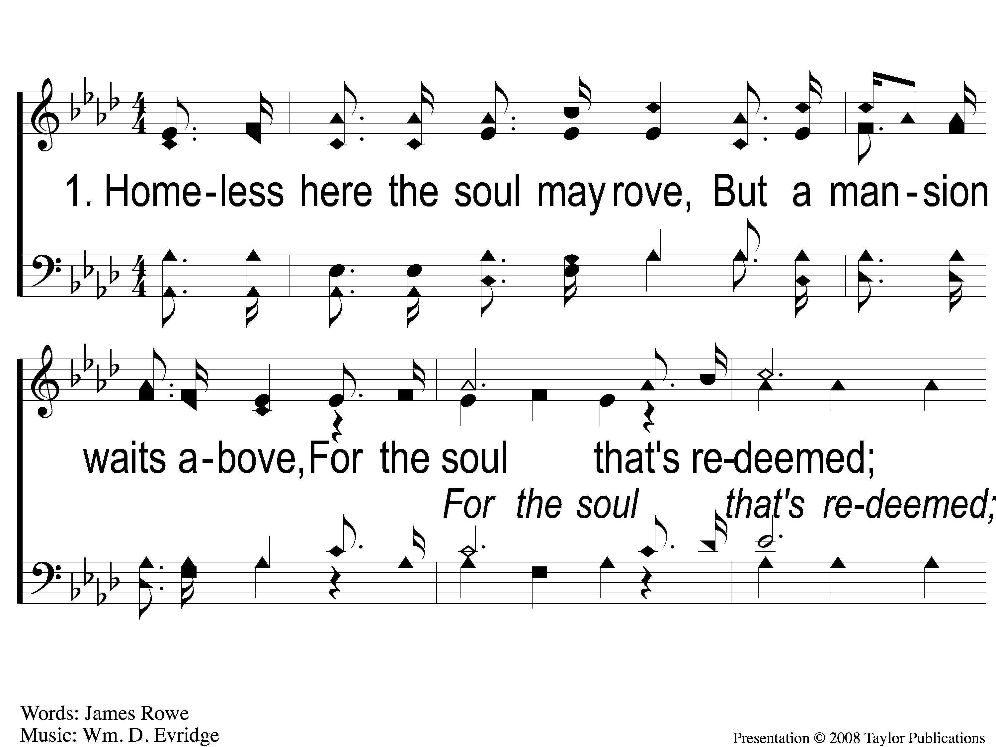
1-1 For the Soul That’s Redeemed
For the Soul that’s Redeemed
112

Slide 2
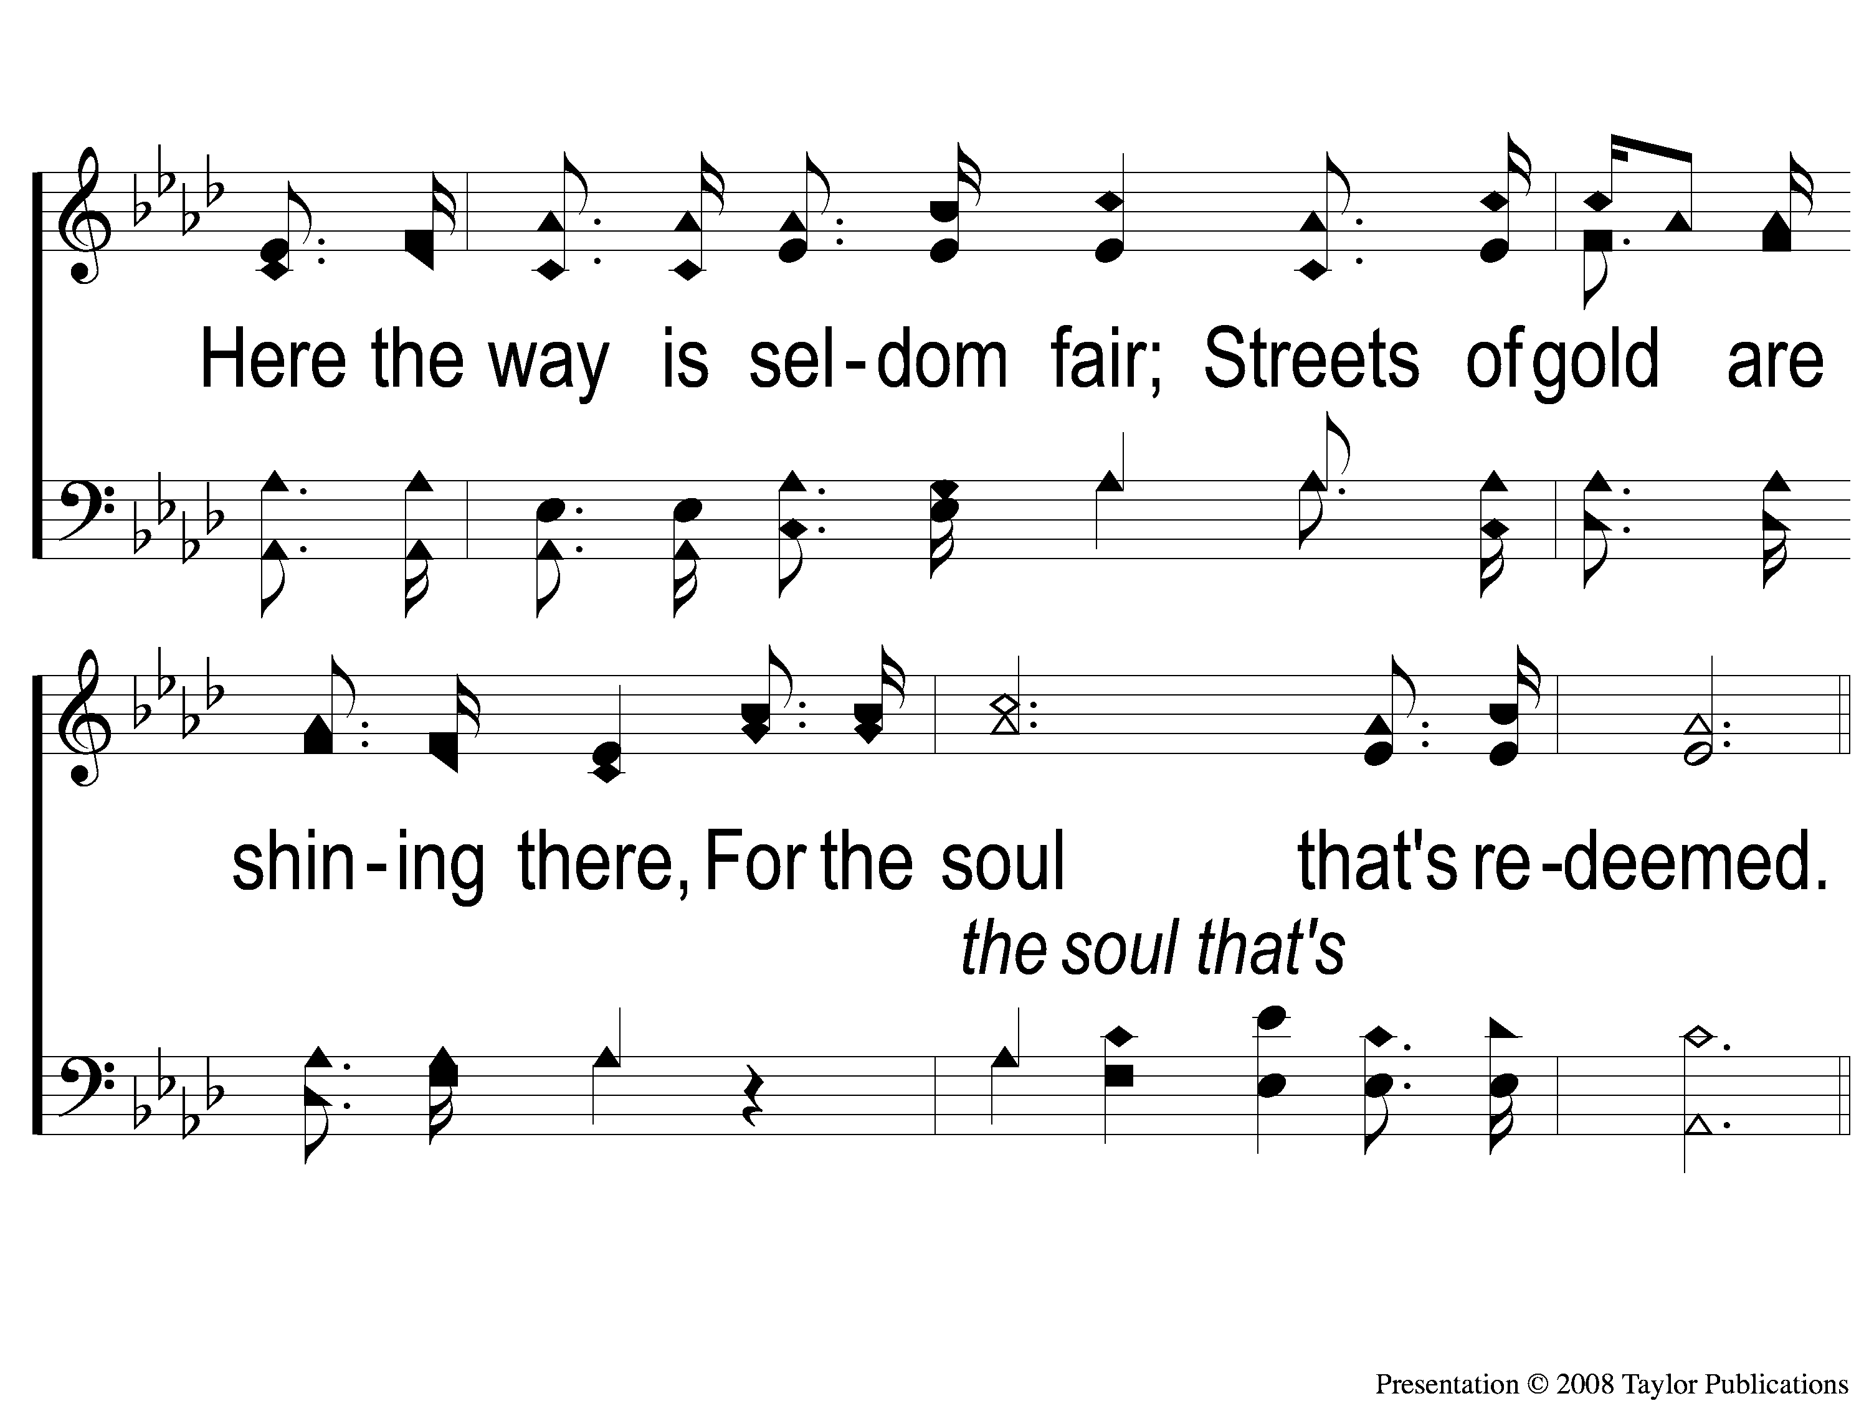
1-2 For the Soul That’s Redeemed
For the Soul that’s Redeemed
112

Slide 3
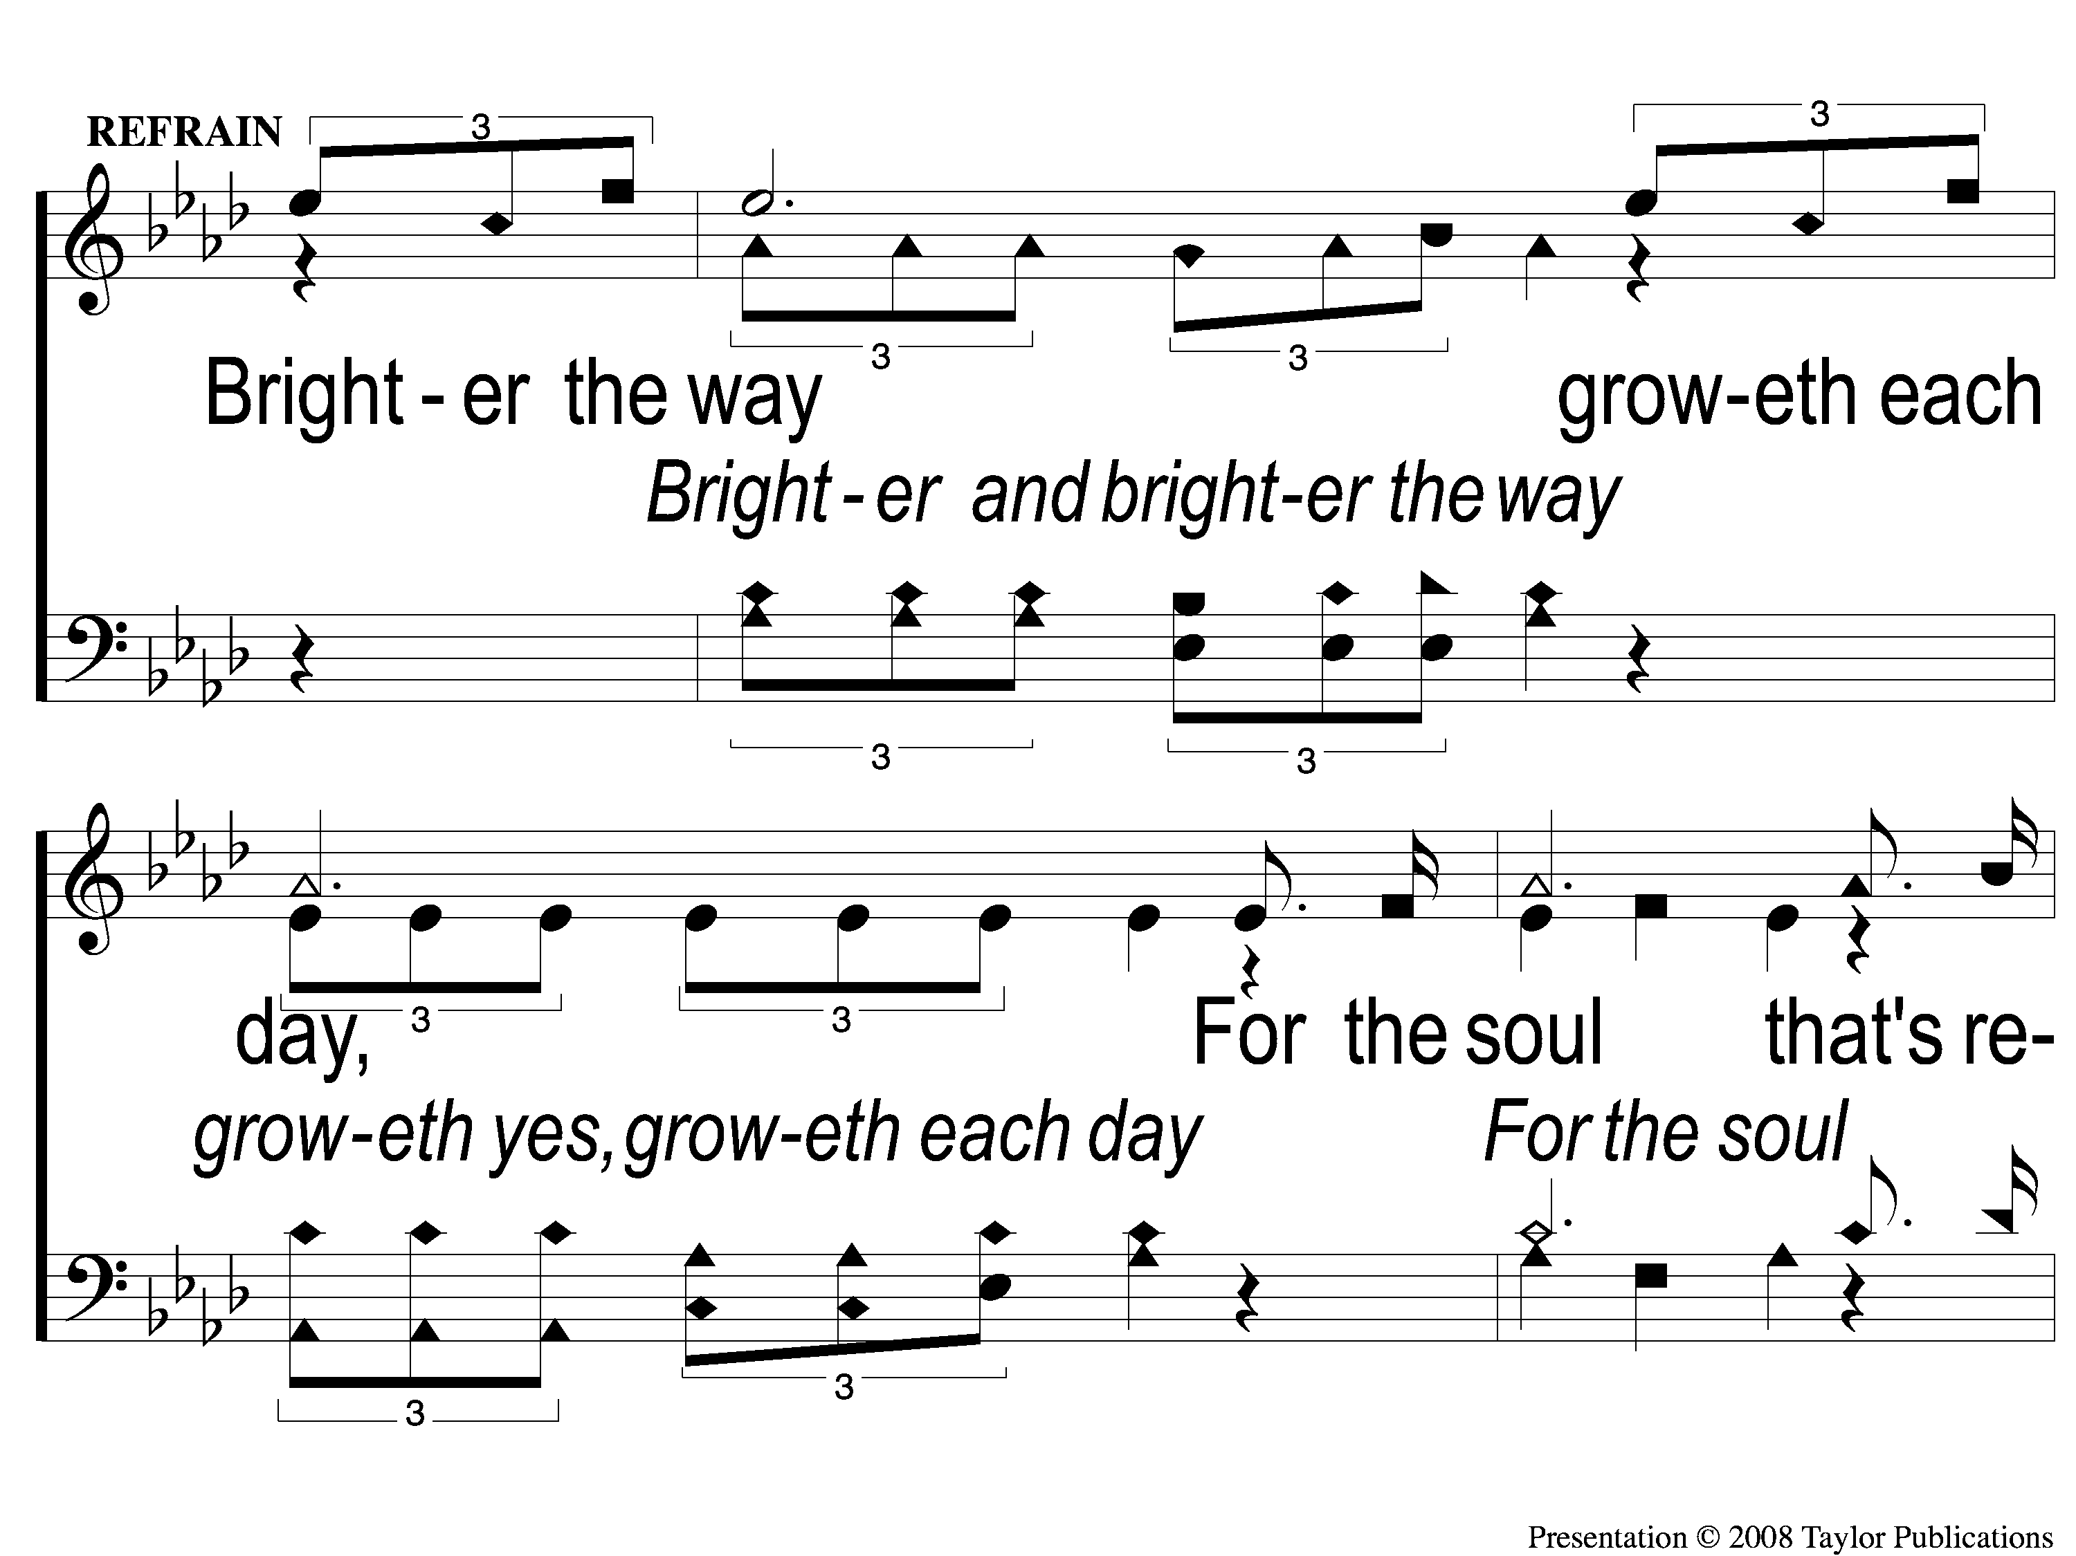
C-1 For the Soul That’s Redeemed
For the Soul that’s Redeemed
112

Slide 4
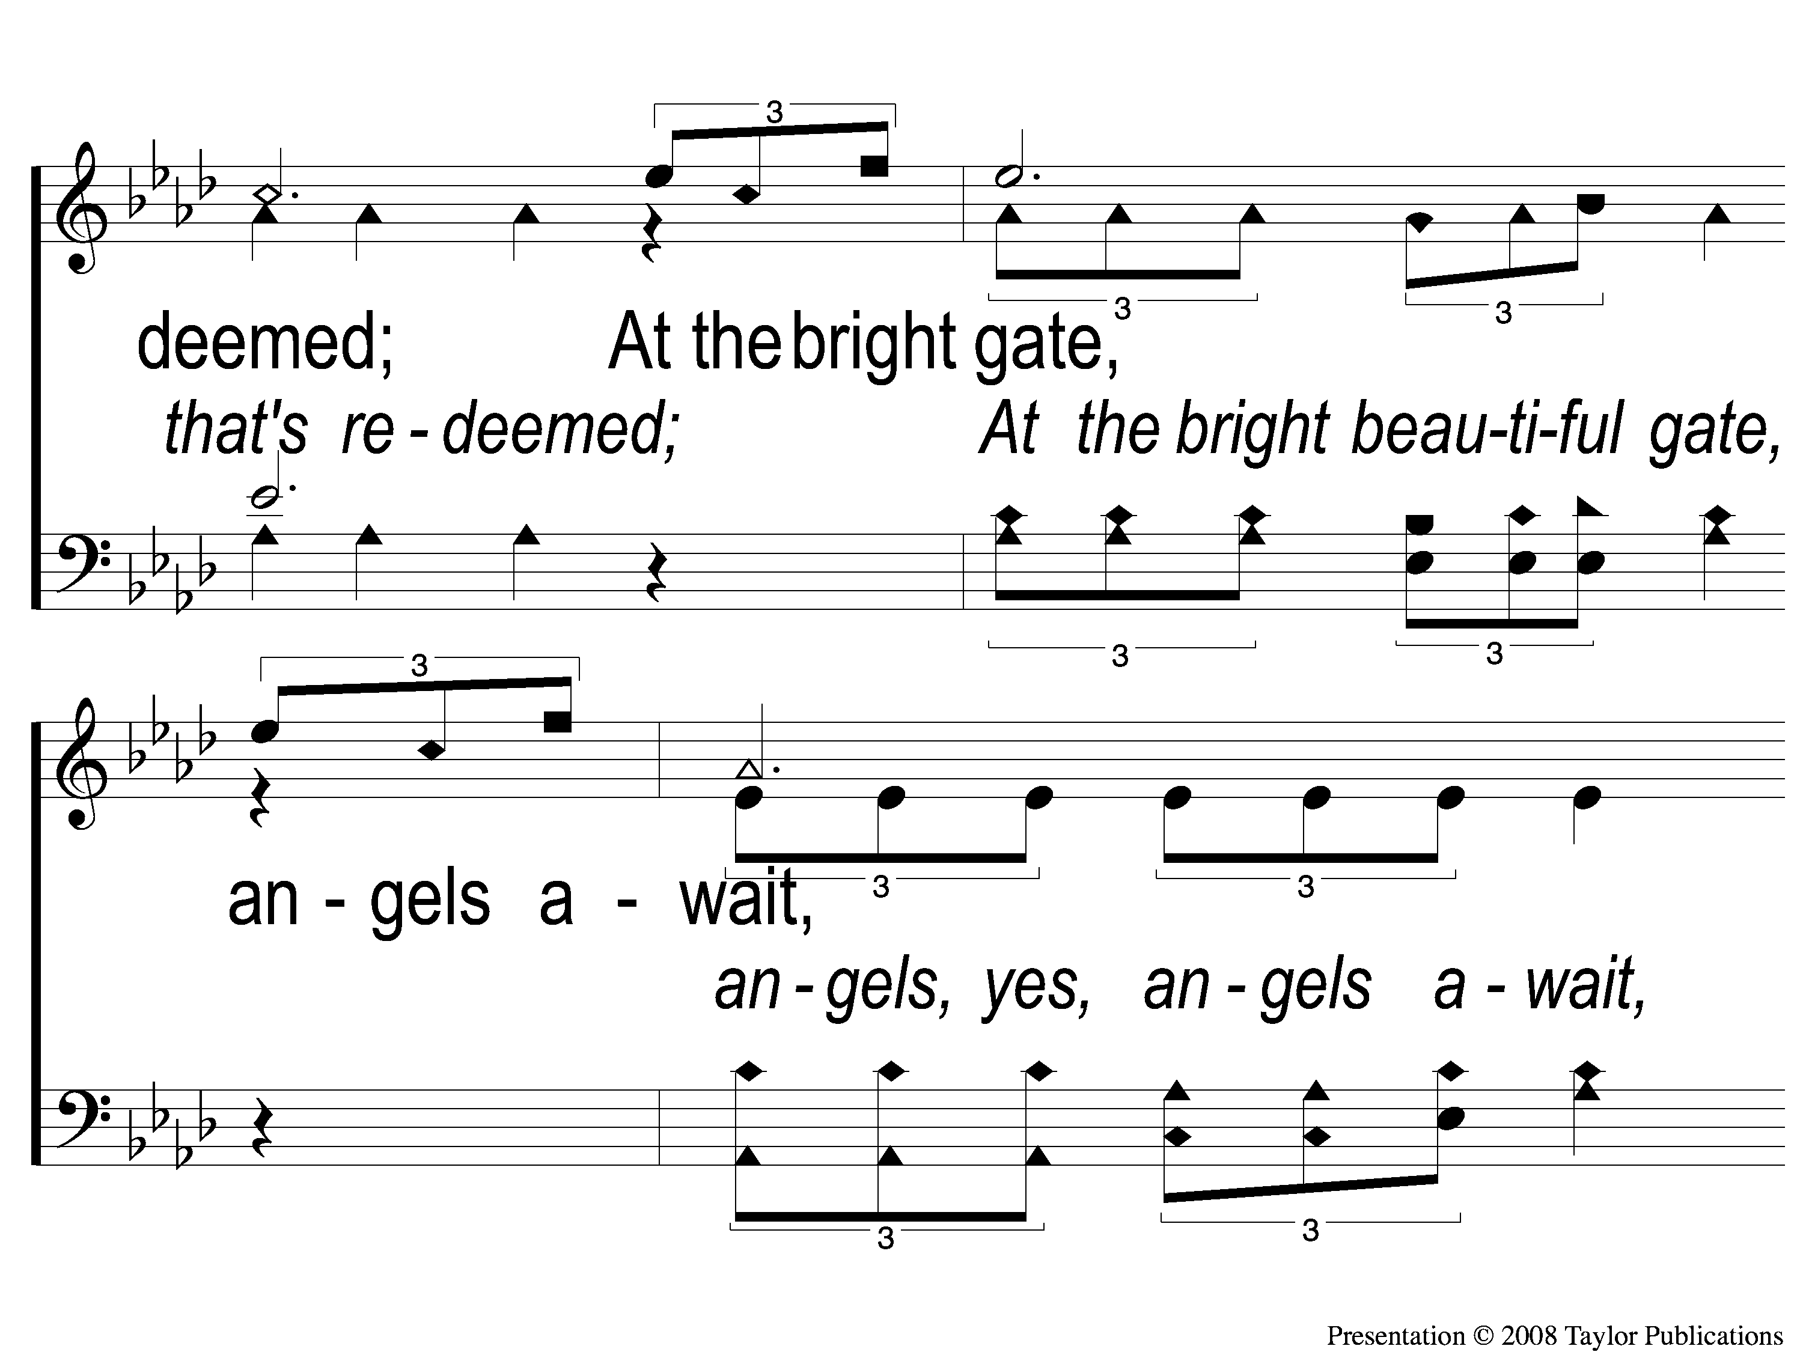
C-2 For the Soul That’s Redeemed
For the Soul that’s Redeemed
112

Slide 5
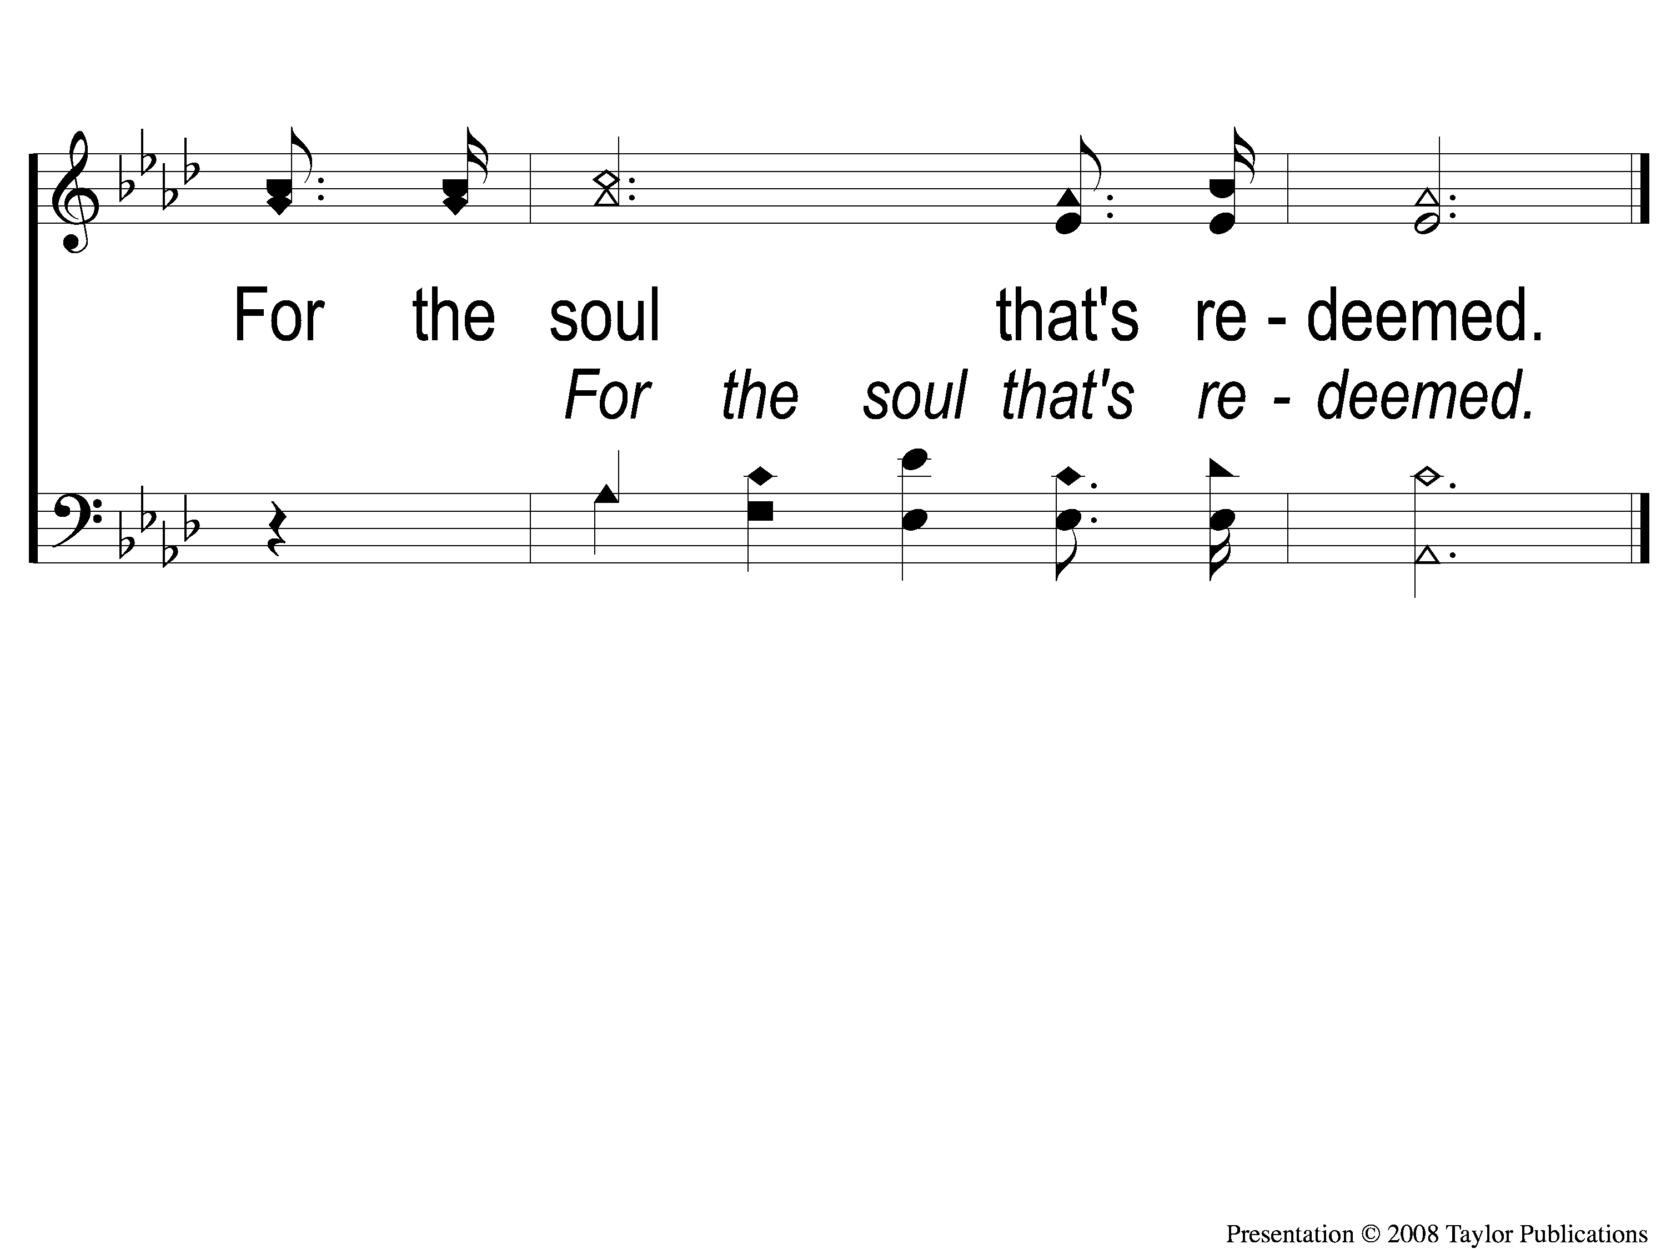
C-3 For the Soul That’s Redeemed
For the Soul that’s Redeemed
112

Slide 6
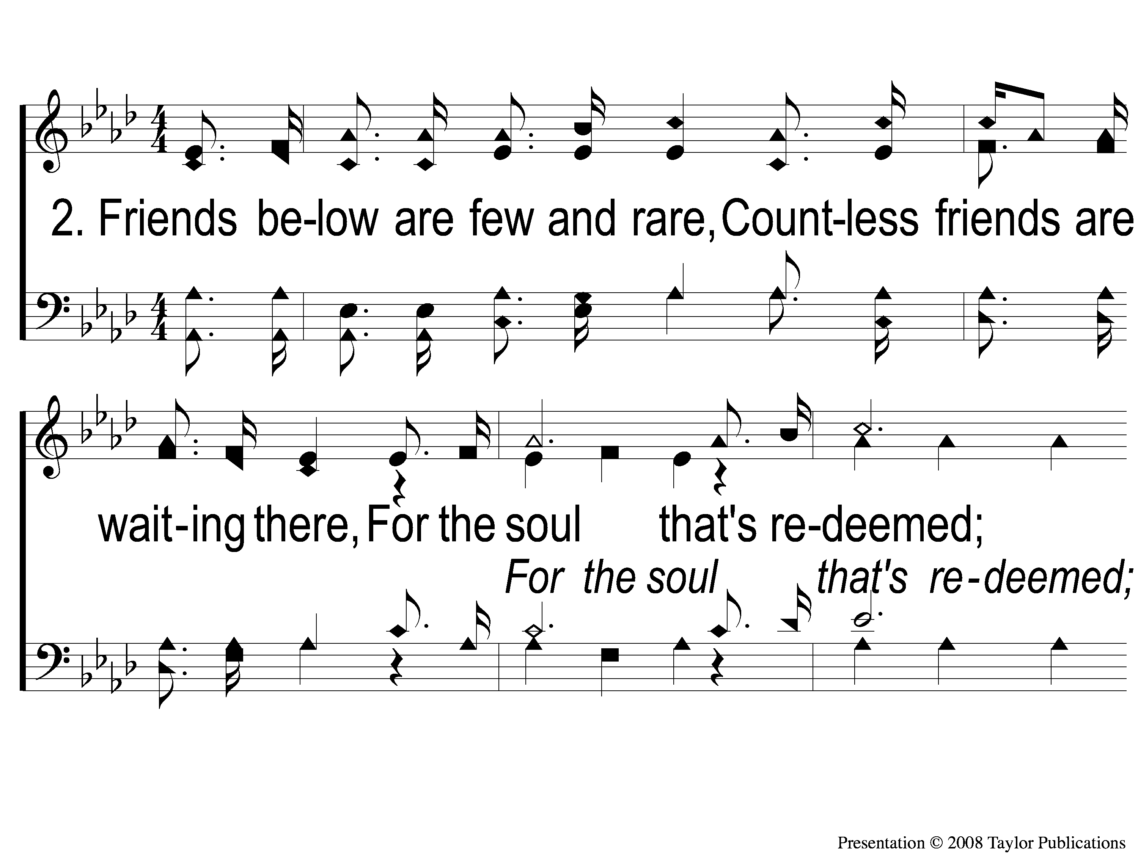
2-1 For the Soul That’s Redeemed
For the Soul that’s Redeemed
112

Slide 7
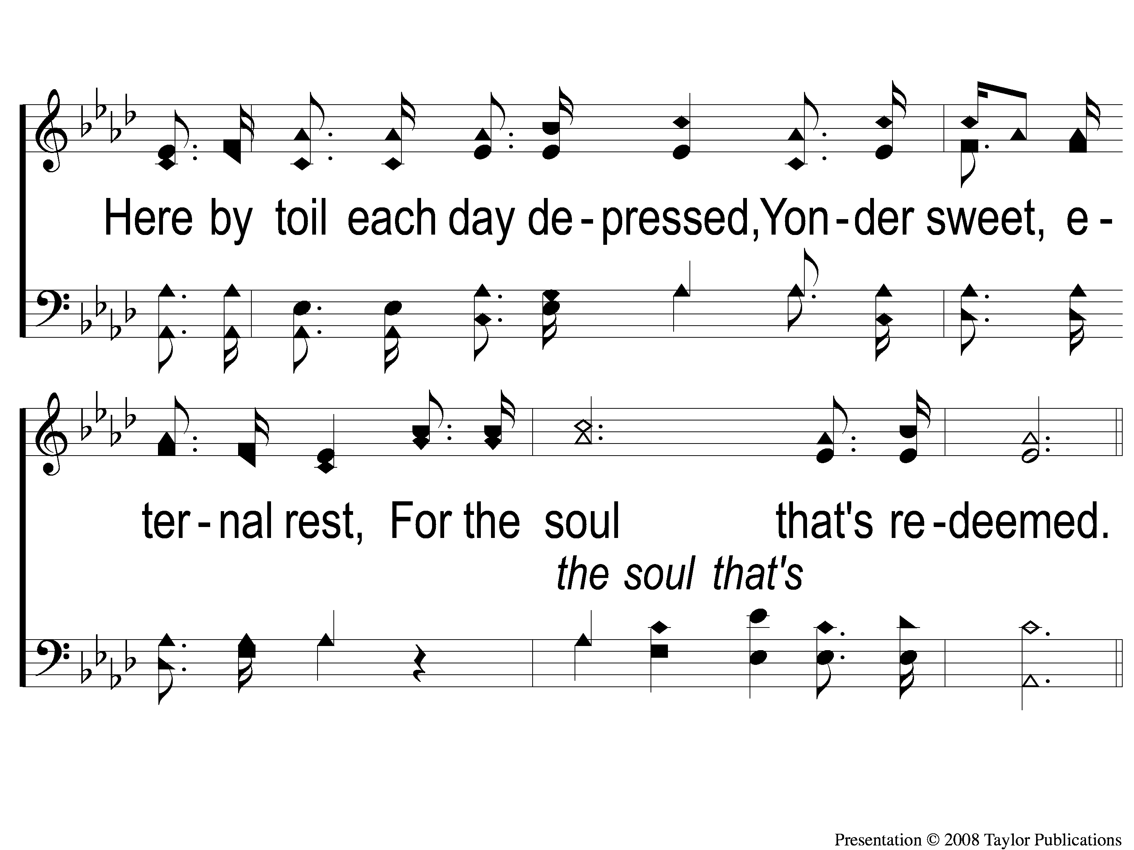
2-2 For the Soul That’s Redeemed
For the Soul that’s Redeemed
112

Slide 8
C-1 For the Soul That’s Redeemed
For the Soul that’s Redeemed
112

Slide 9
C-2 For the Soul That’s Redeemed
For the Soul that’s Redeemed
112

Slide 10
C-3 For the Soul That’s Redeemed
For the Soul that’s Redeemed
112

Slide 11
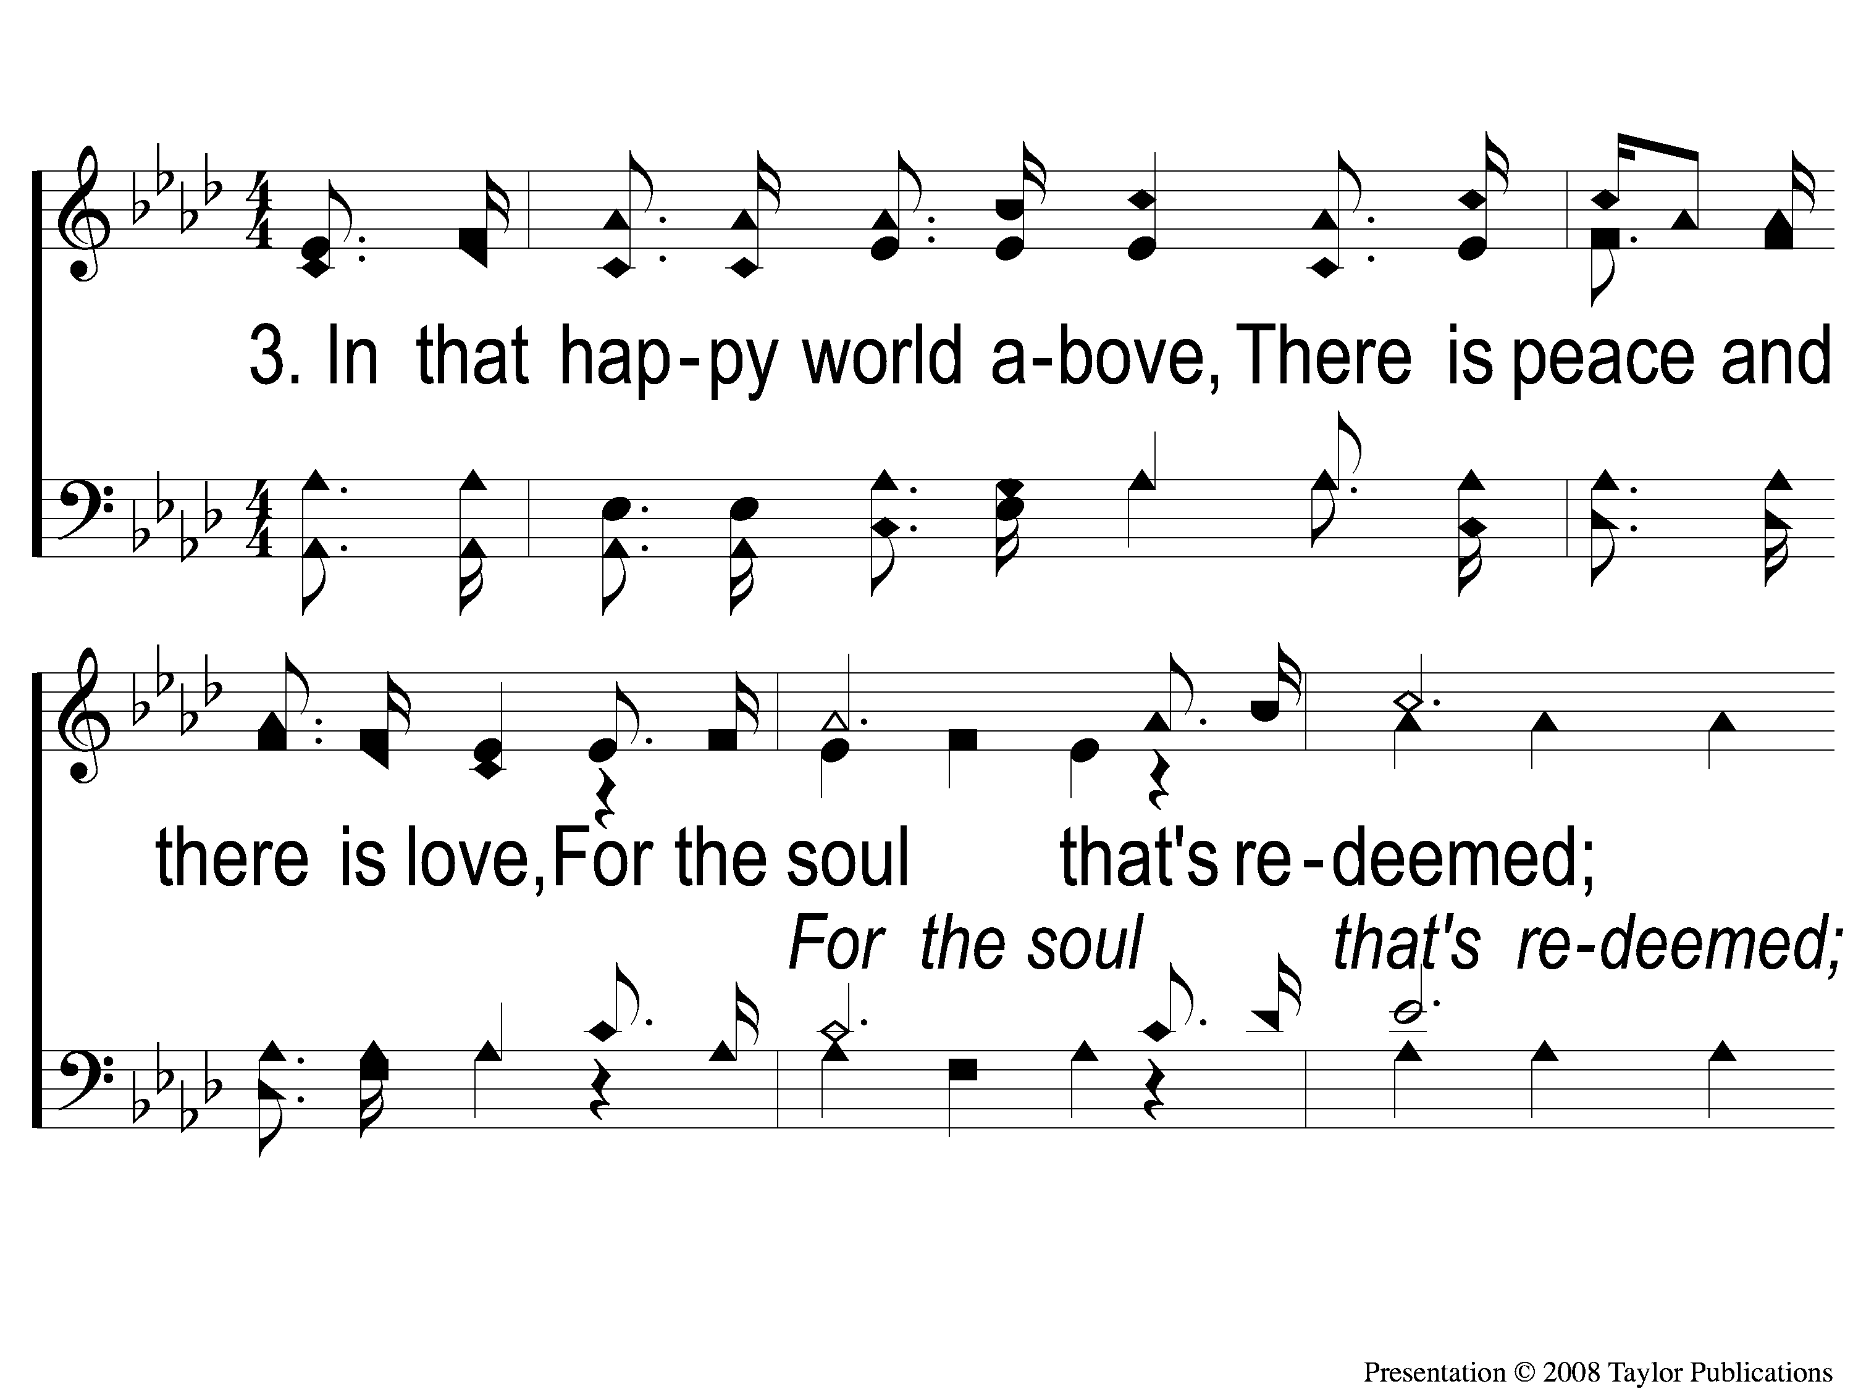
3-1 For the Soul That’s Redeemed
For the Soul that’s Redeemed
112

Slide 12
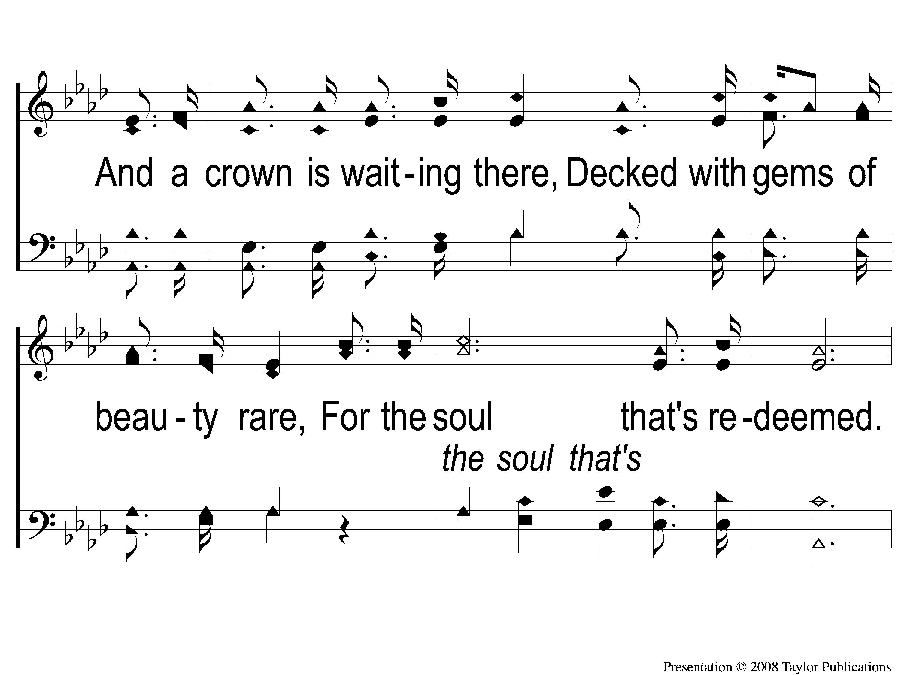
3-2 For the Soul That’s Redeemed
For the Soul that’s Redeemed
112

Slide 13
C-1 For the Soul That’s Redeemed
For the Soul that’s Redeemed
112

Slide 14
C-2 For the Soul That’s Redeemed
For the Soul that’s Redeemed
112

Slide 15
C-3 For the Soul That’s Redeemed
For the Soul that’s Redeemed
112

